Slide 1

Turing Machines
By:
Dr. Sandeep Rathor

Slide 2
Syllabus or Contents
Turing machines (TM):
Basic Model, Definition and Representation,
TM for Computing Integer Functions,
Variants of Turing Machine and their equivalence,
Universal TM,
Church’s Thesis,
Recursive and Recursively Enumerable Languages,
Halting Problem,
Introduction to Computational Complexity

Slide 3
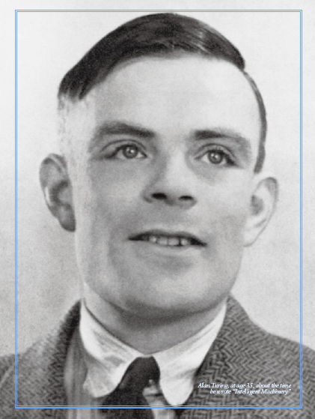
Foundation
The theory of computation and the practical application it made possible — the computer — was developed by an Englishman called Alan Turing.

Slide 4
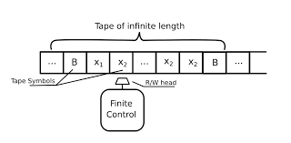
Turing Machine
M = (Q, Σ, Γ, δ, q₀, B, F)
Q - The finite set of states of the finite control
Σ - The finite set of input symbols
Γ– The set of tape symbols; Σ ⊂ Γ
δ - Q x Γ → Q x Γ x {L, R}
q₀ – The initial state
B or # or - Blank Symbol; B ∈ Γ but B ∉ Σ
F – Accept & Halt State; F ∈ Q

Slide 5

Computations: The Start Configuration
start state
q₀
head: on the leftmost square
the input: starting from left
Note: the head cannot move to the left of this square!

Slide 6
A Turing Machine
Tape
......
......
Read-Write head
Control Unit

Slide 7
The Tape
No boundaries -- infinite length
......
......
Read-Write head
The head moves Left or Right

Slide 8
......
......
Read-Write head
The head at each time step:
1. Reads a symbol
2. Writes a symbol
3. Moves Left or Right

Slide 9
Example:
Time 0
......
......
Time 1
......
......
1. Reads
2. Writes
3. Moves Left

Slide 10
Time 1
......
......
Time 2
......
......
1. Reads
2. Writes
3. Moves Right

Slide 11
The Input String
Input string
Blank symbol
......
B
B
B
B
......
B
head
Head starts at the leftmost position
of the input string

Slide 12
Input string
Blank symbol
......
B
B
B
B
......
B
head
Remark: the input string is never empty

Slide 13
States & Transitions
Write
Read
Move Left
Move Right

Slide 14
Example:
Time 1
......
B
B
......
B
B
B
current state

Slide 15
Time 1
......
......
Time 2
......
......

Slide 16
Example:
Time 1
......
......
Time 2
......
......

Slide 17
Example:
Time 1
......
......
Time 2
......
......

Slide 18
Determinism
Turing Machines are deterministic
Allowed
Not Allowed
No lambda transitions allowed

Slide 19
Partial Transition Function
Example:
......
......
Allowed:
No transition
for input symbol

Slide 20
Halting
The machine halts if there are
no possible transitions to follow

Slide 21
Example:
......
......
No possible transition
HALT!!!

Slide 22
Acceptance
If machine halts
in a final state
Accept Input
If machine halts
in a non-final state
or
If machine enters
an infinite loop
Reject Input

Slide 23
Turing Machine:
Input
alphabet
Tape
alphabet
States
Transition
function
Final
states
Initial
state
blank

Slide 24

Designing of Turing Machine: Basics
By:
Dr. Sandeep Rathor

Slide 25
Turing Machine Example
A Turing machine that accepts the language: a*
Time 0
B
B
B
B
B B, L

Slide 26
Time 1
B
B
B
B
B B, L

Slide 27
Time 2
B
B
B
B
B B, L

Slide 28
Time 3
B
B
B
B
B B, L

Slide 29
Time 4
B
B
B
B
Halt & Accept
B B, L

Slide 30
Rejection Example
Time 0
B
B
B
B
B
B,
L

Slide 31
Time 1
B
B
No possible Transition
Halt & Reject
B
B,
L

Slide 32
Because of the infinite loop:
The final state cannot be reached
The machine never halts
The input is not accepted

Slide 33
Turing Machine Example
A Turing machine that accepts the language:
B B, L
qf

Slide 34
Construction of Turing Machines
By:
Dr. Sandeep Rathor

Slide 35
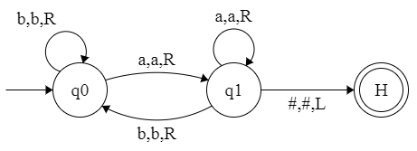
Design a TM to recognize L = {w | w ends with a}
B,B,L
a | a | b | a | B | B | …

Slide 36
L = { a^{n}b^{n}| n ≥ 1 }
a,a,R
b,b,R
a,x,R
B,B,L
y,y,L
b,y,L
y,y,R
x,x,R
b,b,L
a,a,L

Slide 37
L = { a^{n}b^{m}| n <m }
,R

Slide 38
Equal no of a’s and b’s over (a,b)

Slide 39
Construction of Turing Machines
By:
Dr. Sandeep Rathor

Slide 40
Building a TM for a Simple Language
L = { a^{n}b^{n}c^{n} | n > 0 }
Examples:
Member of L:
aaabbbccc
Non-Member of L:
aaabbcccc

Slide 41
L = { a^{n}b^{n}c^{n} | n > 0 }

Slide 42
Construction of Turing Machines
By:
Dr. Sandeep Rathor

Slide 43
Describe a TM that decides the language L = {wwR | w ∈ {a, b}*}
a,a,R
b,b,R
a,a,L
b,b,L
B,B,L
q2
a,B,L
a,B,R
q1
q3
B,B,R
b,B,L
b,B,R
B,B,L
B,B,N
q5
q4
qf
a,a,R
b,b,R

Slide 44
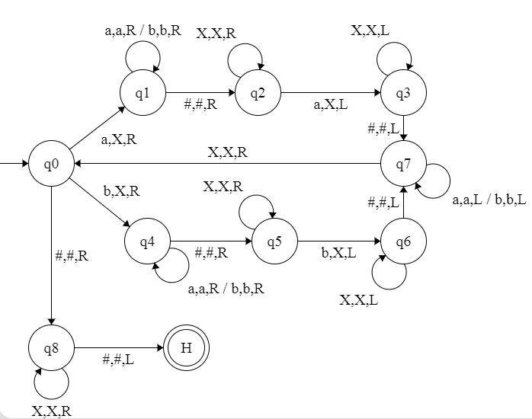
Describe a TM that decides the language L = {w#w | w ∈ {a, b}*}
B,B,R

Slide 45
Computing Functions with TM
By:
Dr. Sandeep Rathor

Slide 46
Design a TM to compute f(n) = n + 1
Hint
S111 ⊢ 1S11 ⊢ 11S1 ⊢ 111SB ⊢ 1111HB

Slide 47
Design a TM to compute One’s Complement when i/p is given in binary
M = (Q, Σ, Τ, δ, S, B, H)
Q = {S, H}
Σ = {0, 1}
Τ = {0, 1, B}
δ = {(S, 0, 1, S, R), (S, 1, 0, S, R), (S, #, #, H, R)}
Consider f(100). Write its Computation History
S100 ⊢ 0S00 ⊢ 01S0 ⊢ 011SB ⊢ 011HB

Slide 48
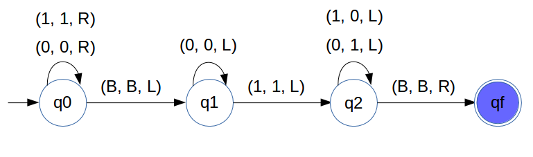
Computing 2,s Complement
Hint:
MSB LSB
1 1 1 0 1 1 0 0
0 0 0 1 0 0 1 1 1’s Complement
1 2’s
0 0 0 1 0 1 0 0 2’s

Slide 49
Computing Functions with TM
By:
Dr. Sandeep Rathor

Slide 50
A function may have many parameters:
Example:
Addition function

Slide 51
Integer Domain
Decimal:
5
Binary:
101
Unary:
11111
We prefer unary representation:
easier to manipulate with Turing machines

Slide 52
Start
B
B
initial state
0 is the delimiter that
separates the two numbers
Finish
B
B
final state

Slide 53
Turing machine for function
B,B,L
1,B,R
B,B,R

Slide 54
Execution Example:
Time 0
(2)
B
B
(2)
Final Result
B
B

Slide 55
Time 0
B
B,B,L
1,B,R
B,B,R

Slide 56
Time 1
B,B,L
1,B,R

Slide 57
Time 2
B,B,L
1,B,R

Slide 58
Time 3
B,B,L
1,B,R

Slide 59
Time 4
B,B,L
1,B,R

Slide 60
Time 5
B
B,B,L
1,B,R
B,B,R

Slide 61
Time 6
1,B,R
B,B,R

Slide 62
Time 7
B
B
B
q4

Slide 63
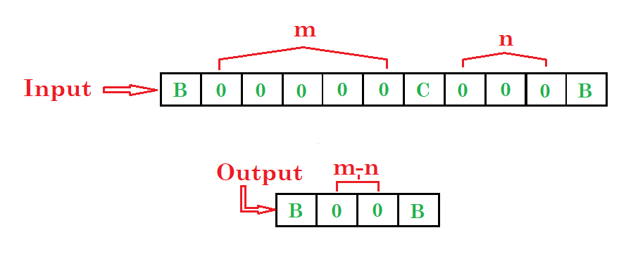
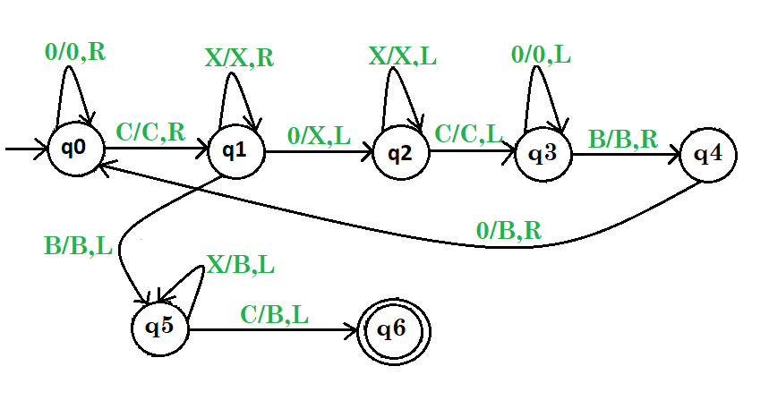

Slide 64
Another Example
The function
is computable
is integer
Turing Machine:
Input string:
unary
Output string:
unary

Slide 65
Design a TM that copies strings of 1 f(n) = 2n
… | B | 1 | 1 | 1 | B | …
… | B | 1 | 1 | 1 | 1 | 1 | 1 | B | …
First write an algorithm.
Replace every 1 by x
Find the rightmost x & replace it by 1
Travel to the right end of the current non-blank region & write a 1 there
Repeat steps 2 & 3 until there are no more x’s

Slide 66
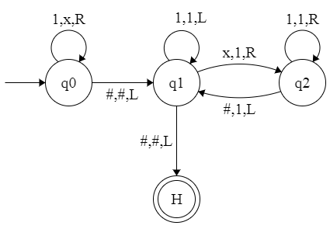
δ (q0, 1) = (q0, x, R)
(q0, B) = (q1, B,L)
(q1, 1) = (q1, 1, L)
δ (q1, x) = (q2, 1, R)
δ (q2, 1) = (q2, 1, R)
(q2, B) = (q1, 1, L)
(q1, B) = (H, B, L)
B,B,L
B,1,L
B,B,L

Slide 67
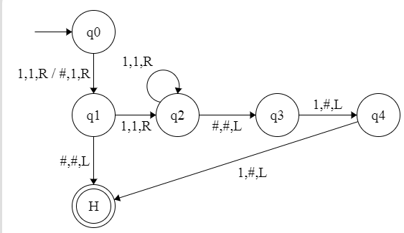
Design a TM to compute

Slide 68
Variants of Turing Machine
By:
Dr. Sandeep Rathor

Slide 69
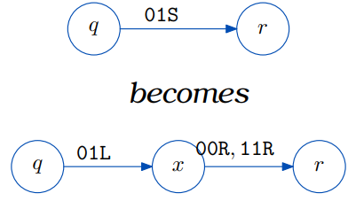
Variants of TM
Turing Machine with Stay Option
In standard TM, the R/W head must move either Left or right
We can define TM with Stay-option
δ: Q x Τ → Q x Τ x {L, R, S}
One can achieve the net effect of stay-in place by moving the head off the cell and immediately moving it back!
The head can stay in the same position
Left, Right, Stay

Slide 70
Example:
Time 1
Time 2

Slide 71
Two-way infinite Tape Turing Machine
Infinite tape of two-way infinite tape Turing machine is unbounded in both directions left and right.
Let M₀ with one-way infinite tape TM imitating one-way infinite tape TM, M
The first thing that M₀ needs to do is to mark the start of its tape.
It can move the whole string to the right every time M moves left to the marker.
… | # | a | b | # | …
What is the behaviour when started on the tape
… | # | 1 | 0 | 1 | 0 | # | …
… | # | 1 | 0 | 1 | # | …

Slide 72
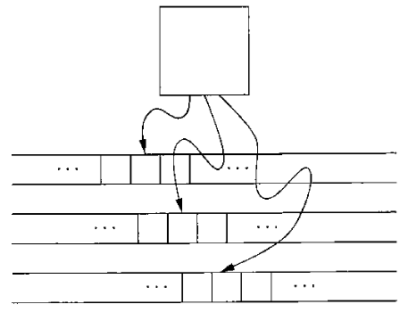
Multi Tape Turing Machine
TM with k tapes and k heads.
Each tape has its own head for reading and writing.
Initially the input appears on tape 1, and the others start out blank.
δ: Q × Γ^{k} → Q × Γ^{k} × {L,R}^{k}
δ(q_{i}, a₁, …, a_{k}) = (q_{j}, b₁, …, b_{k}, L, R, …, L)

Slide 73
Model of Multitape Turing Machines
Control unit
Tape 1
Tape 2
Input

Slide 74
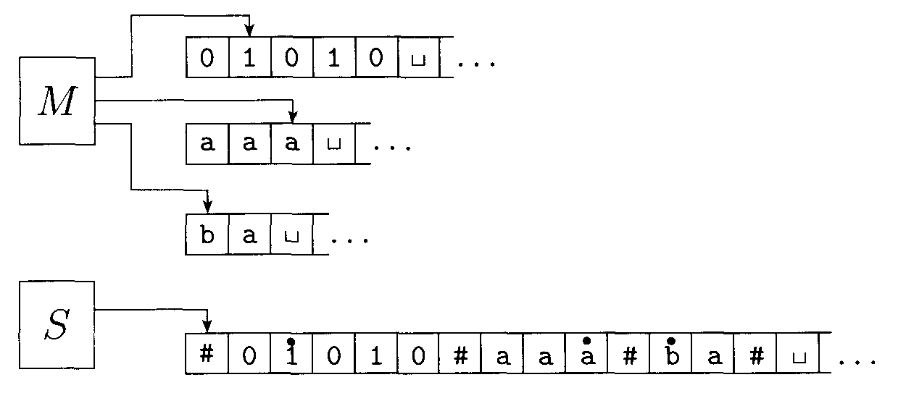
Representing three tapes with one

Slide 75
4. Multi Track Turing Machine
track 1
track 2
one symbol
Transition on multi track TM…..contd…

Slide 76
Transition on multi track TM…
track 1
track 2
track 1
track 2

Slide 77
5. Nondeterministic Turing Machine
At any point in a computation the machine may proceed according to several possibilities.
δ: Q × Γ → 2^{(Q × Γ × {L,R})}
δ(q_{i}, a) = {(q₁, b, R), (q₂, c, L), …, (q_{m}, d, R)}
We can simulate any nondeterministic TM N with a deterministic TM D.
The idea behind the simulation is to have D try all possible branches of N's nondeterministic computation.
If D ever finds the accept state on one of these branches, D accepts. Otherwise, D's simulation will not terminate.

Slide 78
Time 0
Time 1
Choice 1
Choice 2

Slide 79
We view N's computation on an input w as a tree. Each branch of the tree represents one of the branches of the non-determinism.
Each node of the tree is a configuration of N.
The root of the tree is the start configuration.
The TM D searches this tree for an accepting configuration.
Can we use the depth-first search strategy that goes all the way down one branch before backing up to explore other branches?
We use a strategy that explores all branches to the same depth before going on to explore any branch to the next depth.
This method guarantees that D will visit every node in the tree until it encounters an accepting configuration.
Notes:
If D were to explore the tree in this manner, D could go forever down one infinite branch and miss an accepting configuration on some other branch. Hence we design D to explore the tree by using breadth first search
instead.

Slide 80
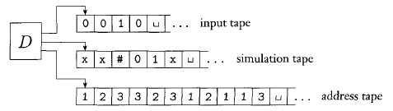
The simulating deterministic TM D has three tapes. (We know that this arrangement is equivalent to having a single tape.)
Tape 1 always contains the input string and is never altered.
Tape 2 maintains a copy of N's tape on some branch of its nondeterministic computation.
Tape 3 keeps track of D's location in N's nondeterministic computation tree.
Remark* Non-Deterministic Machines have the same power with Deterministic machines

Slide 81
6. Semi Infinite Tape Turing Machine
.........
*Standard Turing machines simulate Semi-infinite tape machines.
Standard Turing machine
.........
.........
Semi-infinite tape Turing machine
.........

Slide 82
7. OFF- Line Turing Machine
Input File
read-only
Control Unit
read-write
Tape

Slide 83
Off-line machines simulate
Standard Turing Machines:
Off-line machine:
1. Copy input file to tape
2. Continue computation as in
Standard Turing machine

Slide 84
Standard machine
Off-line machine
Input File
Tape
1. Copy input file to tape

Slide 85
Standard machine
Off-line machine
Input File
Tape
2. Do computations as in Turing machine

Slide 86
Church Turing Thesis
By:
Dr. Sandeep Rathor

Slide 87
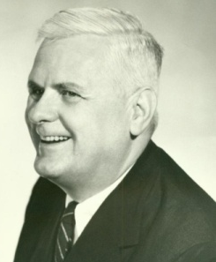
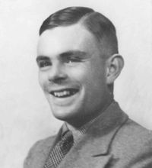
Church - Turing Thesis
Alonzo Church
(1903-1995)
Alan Turing
(1912-1954)
Some common interpretations of the thesis are
Every algorithmically computable function is TM-computable.
A function is computable iff it can be solved by a Turing Machine
Thesis not Theorem: because we cannot prove this.. with a counter example we could disprove it (but this has not been done yet).
Notes:
In computability theory, the Church–Turing thesis (also known as computability thesis,[1] the Turing–Church thesis,[2] the Church–Turing conjecture, Church's thesis, Church's conjecture, and Turing's thesis) is a hypothesis about the nature of computable functions.

Slide 88
TM is a general model of computation, is simply to say that any algorithmic procedure that can be carried out at all (by the human or team of human or a computer) can be carried out by a TM. This statement was first formulated by Alenzo church in 1930. it was usually refer to as Church Thesis or Church Turing Thesis.

Slide 89
It is mathematically precise statement b/c we do not have a precise definition of the term “Algorithmic procedure”. Therefore, it is not something that we can prove. (that’s why it is not a theorem)
Since invention of TM however enough evidence has accumulated to cause the church Turing thesis to be generally accepted.

Slide 90
What does the following TM compute?
Test for
n = ε
n = 11
1 → 1 , R
1 → 1, R
q₀
1 → □ , R
q₁
□ → □ , R
q₂
□ → 1 , R
□ → □ , R
□ → □ , R
q_{f}
q₅
□ → □ , L
q₄
□ → 1 , L
q₃
1 → 1, L
1 → 1, L
Notes:
f(n) = 2n

Slide 91
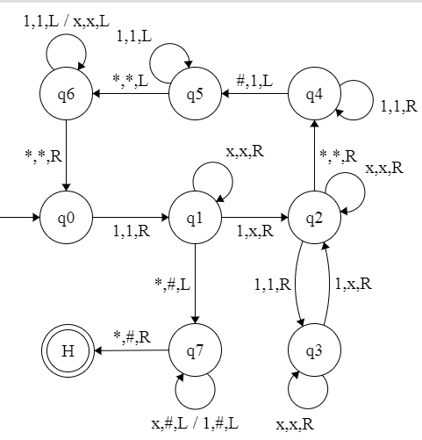
Design a TM for a partially computable function
f(n) = log₂ n
… | # | * | 1 | 1 | 1 | 1 | * | # | …
Notes:
Partially computable bec can be calculated only when n = 2^{p}
Based on idea for L = {w | |w| is a power of 2}

Slide 92
Try to run the machine by hand on Test inputs:
ε (shouldn’t accept)
1 (should accept)
11 (should accept)
111 (shouldn’t accept)
111111 (shouldn’t accept)
11111111 (should accept)

Slide 93
Basis of Computation
Software
or
Hardware
Turing Machines – the formalism of algorithms (that we have studied so far)
Is an “unprogrammable” piece of hardware
Why?
Notes:
Papadimitrou

Slide 94
A Limitation of Turing Machines:
Turing Machines are “hardwired”
they execute only one program
Real Computers are re-programmable

Slide 95
We will see TMs are also software
There is a generic TM that can be programmed,
in about the same way as a general purpose computer can,
to solve any problem that can be solved by a TM.
A modern computer is also “hard wired”
But it is completely flexible
Its job is to execute the instructions stored in its memory, & these can represent any conceivable algorithm.

Slide 96
Universal Turing Machine & Halting Problem of Turing Machine
By:
Dr. Sandeep Rathor

Slide 97
Universal TM
Input : < Description of some TM <M, w >
Output: result of running M on w
Output
Tape
for running
TM-M
starting on tape w
M
Universal
Turing
Machine
w

Slide 98
Universal Turing Machine
simulates any other Turing Machine
Input of Universal Turing Machine:
Description of transitions of
Initial tape contents of

Slide 99
Tape 1
Three tapes
Description of
Universal
Turing
Machine
Tape 2
Tape Contents of
Tape 3
State of

Slide 100
Halting Problem of TM
Halting means Terminating
Unsolvable Problem
Given a program and an input to the program, determine if the program will eventually stop when it is given that input.

Slide 101
Given a TM M and input string w.
Is there an “Algorithm” to decide whether M halts on input w or not?
It is not recursive and it is undecidable.

Slide 102
Halting means that, program on certain input will accept it & halt or reject it & halt and never go into an infinite loop.
So, can we have an algorithm that will tell that the given program will halt or not?
In terms of TM, will it terminate when run on some machine with some particular given input string.

Slide 103
There is no algorithm/ procedure that can determine whether an arbitrary TM, will halt on an arbitrary input string.

Slide 104
Recursively Enumerable & Recursive Languages
By:
Dr. Sandeep Rathor

Slide 105
Definition:
A language is recursive, if some Turing machine accepts it and halts on any input string
In other words:
A language is recursive if there is
a membership algorithm for it

Slide 106
Let be a recursive language
and the Turing Machine that accepts it
For string :
if
then halts in a final state
if
then halts in a non-final state

Slide 107
Remark:
A Problem/ Language with two answers (yes/no) is decidable.
A Problem / Language is undecidable if it is not decidable.

Slide 108
Definition:
A language is recursively enumerable
if some Turing machine accepts it
Remark:
Only acceptable case is in RE

Slide 109
Let be a recursively enumerable language
and the Turing Machine that accepts it
For string :
if
then halts in a final state
if
then halts in a non-final state
or loops forever

Slide 110
Complexity and Computability
By:
Dr. Sandeep Rathor

Slide 111
Complexity and Computability
A formal “measure” of how efficient algorithm or program, is called Complexity.
A formal and intuitive description of computation is called computability.

Slide 112
A complexity class is a collection of problems which can be solved by some computational model.
Complexity class P is defined to be the set of problems solved by a TM in polynomial time. (Decidable)
Ex: Postman problem
Searching shortest path
Searching a matching in a graph

Slide 113
Time Complexity
The time complexity of a TM M is a function denoting the worst-case number of steps M takes on any input of length n.
By convention, n denotes the length of the input.
Assume we're only dealing with deciders, so there's no need to handle looping TMs.

Slide 114
The Class P
P is the class of languages that are decidable in polynomial time on a deterministic single-tape Turing machine.
Notes:
P class, wrt Computers
• Problems with at least one algorithm that solves the problem in polynomial time wrt to the input size.
• Polynomial time
– The number of steps needed relates polynomially to the size of the input.
– O(n²), O(n⁹), O(n^{c}), where c is a constant.
– but NOT O(n!), O(2^{n}), when n is the size of the input.

Slide 115
Class P is important because:
P is invariant for all models of computation that are polynomially equivalent to the deterministic single-tape Turing machine.
P is a mathematically robust class. It isn't affected by the particulars of the model of computation that we are using.
P roughly corresponds to the class of problems that are realistically solvable on a computer.
When a problem is in P, we have a method of solving it that runs in time n^{k} for some constant k. Once a polynomial time algorithm has been found for a problem that formerly appeared to require exponential time, some key insight into it has been gained, and further reductions in its complexity usually follow, often to the point of actual practical utility.

Slide 116
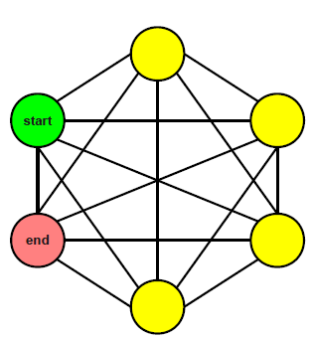
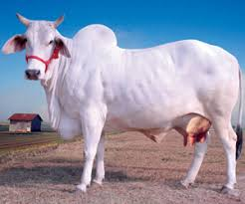
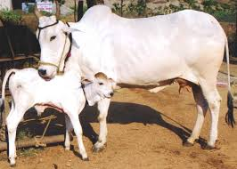
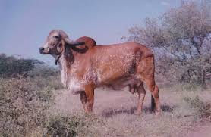
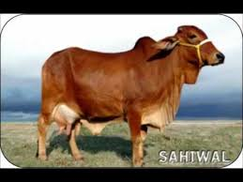

What you can’t do in polynomial time
How many subsets of this set are there?
How many simple paths are there from the start node to the end node?

Slide 117
An Interesting Observation
There are (at least) exponentially many objects of each of the preceding types.
However, each of those objects is not very large.
Each simple path has length no longer than the number of nodes in the graph.
Each subset of a set has no more elements than the original set.
This brings us to our next topic...

Slide 118
The Class NP
We can avoid brute-force search in many problems and obtain polynomial time solutions.
However, attempts to avoid brute force in certain other problems, including many interesting and useful ones, haven't been successful, and polynomial time algorithms that solve them aren't known to exist.

Slide 119
Why have we been unsuccessful in finding polynomial time algorithms for these problems?
We don't know the answer to this important question.
Perhaps
these problems have, as yet undiscovered, polynomial time algorithms that rest
on unknown principles.
Or possibly some of these problems simply cannot be
solved in polynomial time. They may be intrinsically difficult.
One remarkable discovery concerning this question shows that the complexities of many problems are linked.
A polynomial time algorithm for one such problem can be used to solve an entire class of problems.

Slide 120
A Hamiltonian path in a directed graph G is a directed path that goes through each node exactly once.
We consider a special case of this problem where the start node and target node are fixed.
HAMPATH = {<G,s,t> | G is a directed graph with a Hamiltonian path from s to t}
1
5
3
∈ PATH?
s
t
∈ HAMPATH?
4
2
6

Slide 121
Does this graph have a Hamiltonian path?
s
t

Slide 122
No fast algorithm for HAMPATH
But
If I somehow discovered such a path (perhaps using the exponential time algorithm), I could easily convince you of its existence, simply by presenting it.
Polynomial Verifiability
Verifying the existence of a Hamiltonian path may be much easier than determining its existence.

Slide 123
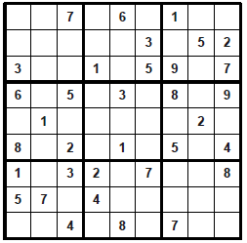
Does a Sudoku grid have a solution?
M = “On input ⟨S⟩, an encoding of a Sudoku puzzle:
Non deterministically guess how to fill in all the squares.
Deterministically check whether the guess is correct.
If so, accept; if not, reject.”

Slide 124
P is the class of decision problems that can be efficiently solved.
We now define the complexity class NP that aims to capture the set of problems whose solutions can be efficiently verified.

Slide 125
NP is the class of languages that have polynomial time verifiers.
The class NP is important because it contains many problems of practical interest.
The term NP comes from nondeterministic polynomial time and is derived from an alternative characterization by using nondeterministic polynomial time Turing Machines.

Slide 126
Some problems may not be polynomially verifiable!!!
The complement of the HAMPATH problem.
Even if we could determine (somehow) that a graph did not have a Hamiltonian path, we don't know of a way for someone else to verify its nonexistence without using the
same exponential time algorithm for making the determination in the first place.

Slide 127
Problems in Class NP
P ⊆ NP
The decision version of the travelling salesman problem is in NP. Given an input matrix of distances between n cities, the problem is to determine if there is a route visiting all cities with total distance less than k. A proof can simply be a list of the cities. Then verification can clearly be done in polynomial time.
The decision version of the integer factorization problem: given integers n and k, is there a factor f with 1 < f < k and f dividing n?
The Subgraph isomorphism problem of determining whether graph G contains a subgraph that is isomorphic to graph H.

Slide 128
The question of whether P = NP is one of the greatest unsolved problems in theoretical computer science and contemporary mathematics.
NP
P
Most researchers believe that the two classes are not equal because people have invested enormous effort to find polynomial time algorithms for certain problems in NP, without success.
Researchers also have tried proving that the classes are unequal, but that would entail showing that no fast algorithm exists to replace brute-force search. Doing so is presently beyond scientific reach.
OR
P = NP

Slide 129
An important advance on the P versus NP question came in the early 1970s with the work of Stephen Cook and Leonid Levin.
They discovered certain problems in NP whose individual complexity is related to that of the entire class.
If a polynomial time algorithm exists for any of these problems, all problems in NP would be polynomial time solvable.
These are the NP Complete Problems

Slide 130
“NP-Complete” comes from:
Nondeterministic Polynomial
Complete - “Solve one, Solve them all”
There are more NP-Complete problems than provably intractable problems.
A language B is NP-complete if it satisfies two conditions:
B is in NP, and
Every A in NP is polynomial time reducible to B.

Slide 131
NP Hard
NP-hard (non-deterministic polynomial-time hard), in computational complexity theory, is a class of problems that are, informally, "at least as hard as the hardest problems in NP".
A problem H is NP-hard if and only if there is an NP-complete problem L that is polynomial time Turing-reducible to H (i.e., L ≤_{P} H).
Notes:
This does not require H to be NP.

Slide 132
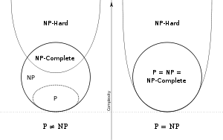
All NP-complete problems are NP-hard but some NP-hard problems are known not to be NP-complete
NP-complete ⊂ NP-Hard

Slide 133
When
a decision version of a combinatorial optimization problem is proved to belong to the class of NP-complete problems,
then the optimization version is NP-hard.
For example,
"is there a Hamiltonian cycle with length less than k" is NP-complete: it is easy to determine if a proposed certificate has length less than k.
The optimization problem, "what is the shortest tour?", is NP-hard, since there is no easy way to determine if a certificate is the shortest.

Slide 134
Examples of NP Hard Problems
The decision subset sum problem, which is this: given a set of integers, does any non-empty subset of them add up to zero? That is a NP Hard decision problem, and happens to be NP-complete.
The optimization problem of finding the least-cost cyclic route through all nodes of a weighted graph. This is commonly known as the traveling salesman problem.

Slide 135
There are decision problems that are NP-hard but not NP-complete, for example the halting problem.
How ?
It is easy to prove that the halting problem is NP-hard but not NP-complete.
Prove Halting problem is not NP-complete.
When do we say that a problem is NP Complete ?
For a problem to be NP complete, it must be decidable – which halting problem is not.

Slide 136
Let G be a CFG in Chomsky Normal form (CNF). In order To derive a string of terminals of length n , the number of productions to be used is
(a) 2n + 1
(b) 2n - 1
(c) 2n
(d) None of these
Recursively enumerable languages are not closed under A. Complementation B. Union C. Intersection D. none of these
Which of the following statement is wrong? A. Every recursive language is recursively enumerable. B. A language is accepted by FA if and only if it is context free. C. Recursive languages are closed under intersection D. A language is accepted by FA if and only if it is right linear.

Slide 137
Which of the following is true? A. The complement of a recursive language is recursive. B. The complement of a recursively enumerable language is recursively enumerable. C. The complement of a recursive language is either recursive or recursively enumerable. D. The complement of a context-free language is context-free.
If there exists a language L, for which there exists a TM, T,
that accepts every word in L and either rejects or loops for every word that is not in L, is called A. Recursive
B. Recursively enumerable
C. NP-HARD
D. none of these
Universal TM influenced the concept of A. stored program computers. B. interpretative implementation of programming language. C. computability. D. all of these.

Slide 138
Which of the following statements is/are true? I. Recursive languages are closed under complementation. II. Recursively enumerable languages are closed under union. III. Recursively enumerable languages are closed under complementation. A. I only
B. I and II
C. II and III
D. III only
Type 0 Grammar is accepted by A. Turing Machine B. PDA C. LBA D. DFA

Slide 139
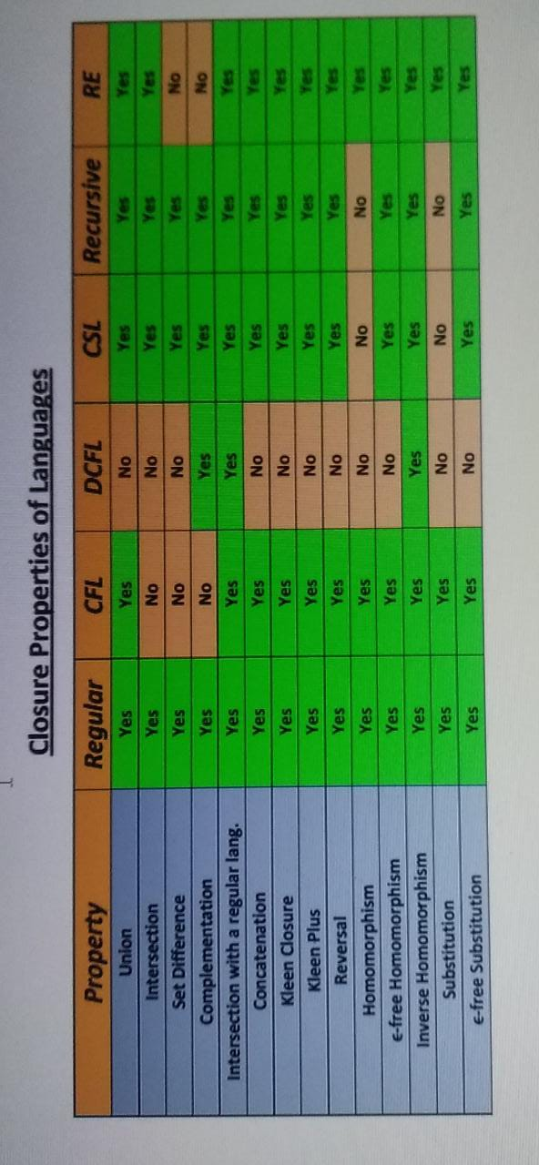

Slide 140
Thank You

